Slide 1
CMSC 426 Principles of Computer Security
Introduction to Networks

Slide 2
Last Class We Covered
Offensive security
What it is
Attacker Lifecycle
Common tools
Demo
Effective Windows Hardening

Slide 3
Any Questions from Last Time?

Slide 4
Today’s Topics
Intro to TCP/IP model
Link layer
Internet layer
Transport layer
Application layer

Slide 5
Internet Protocol Suite

Slide 6
TCP/IP
TCP = Transmission Control Protocol
IP = Internet Protocol
Communication protocols used to connect devices on a network, such as the Internet
Protocols specify how data should be packaged, transmitted, routed, received, etc.
Protocols are split into four layers

Slide 7
TCP/IP Layers
From “lowest” (closer to physical transmission of data) to “highest” (closer to the user application) the layers are...
Link layer
Internet layer (or network)
Transport layer
Application layer
Each of these layers is present on both sides of communication

Slide 8
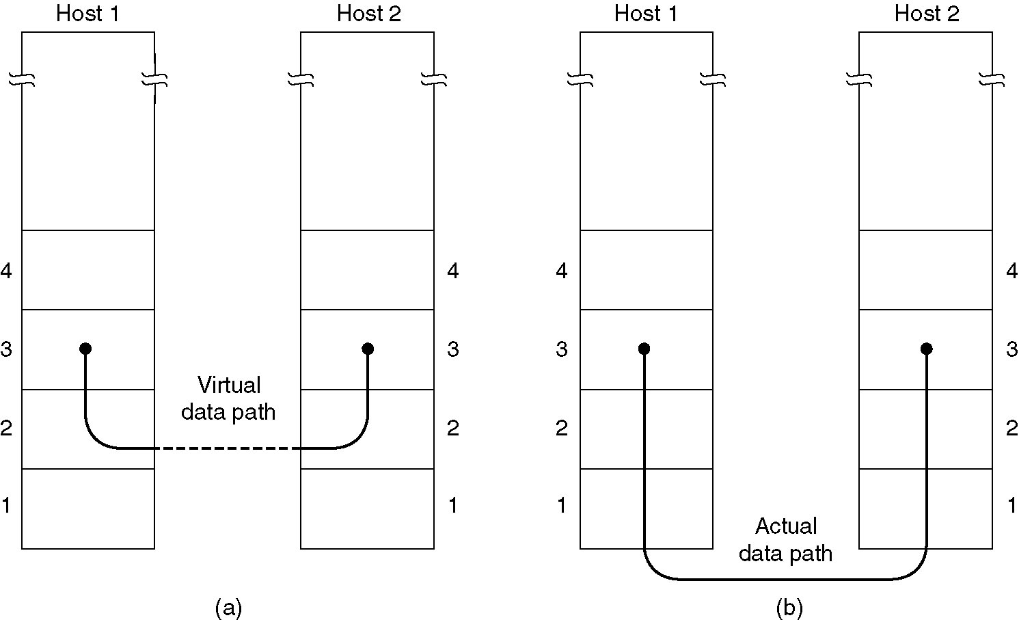
Image from Computer Networks (Tanenbaum)

Slide 9
Link Layer

Slide 10
Link Layer’s Purpose
How data is generated and physically transmitted over the network by connected devices
Interface between physical hardware and the internet layer
Ensures reliable delivery
Controls point-to-point access
Handles error detection and correction

Slide 11
Link Layer: Framing and MAC addresses
Framing encapsulates the data sent from the internet layer within a link-layer frame before transmission over the link
Contains additional header fields with important information
MAC addresses (Media Access Control) are unique identifiers assigned to network interfaces
Similar to a person’s SSN (permanent and very difficult to change)

Slide 12
Internet Layer

Slide 13
Internet Layer’s Purpose
Concerned with getting packets from one end to another
Packet format is defined by the IP (Internet Protocol)
Packet routing and congestion are major issues
Provides only unreliable service and best effort delivery
Makes no guarantee about correct or eventual arrival of packets
Burden of reliability is placed on the hosts instead (not the network)

Slide 14
Internet Layer: Routing Data
Routing algorithms attempt to find the most efficient path between a source and a destination
Completely out of scope for this course
Routing tables contain information about the topology of the network immediately around (directly connected and remote)
Used by the routing algorithm as a sort of “cache” of information, to allow it to more quickly compute the route to be taken

Slide 15
IP Addresses
Unique identifier for a host on a TCP/IP network
32-bit address
Composed of four 8-bit “octets” separated by dots
e.g., 192.168.84.2
IP addresses have 2 parts: network address and host address
Routers don’t know exact host location, just which network it’s on
Network address used by router to get packets to the correct network
Once packet is delivered to correct network, it can be delivered to the host using the host address

Slide 16
Internet Layer: Subnet Mask
Used to determine which half of the IP address is the network address and which half is the host address
The IP address is bitwise-ANDed with the subnet mask to get the network address
The rest of the IP address is the host address
Example of a typical subnet mask:
255.255.255.0

Slide 17
Internet Layer: Subnet Mask Example
192.168.84.2 → 11000000.10101000.01010100.00000010
255.255.255.0 → 11111111.11111111.11111111.00000000
11000000.10101000.01010100.00000010 AND
11111111.11111111.11111111.00000000 =
11000000.10101000.01010100.0000000
Converting back to decimal gives 192.168.84.0 as network address and .2 as the host address

Slide 18
Internet Layer: CIDR Notation
Shorthand notation used to express IP address and subnet mask
Written as the IP address, a slash, and a number (less than 32)
For example:
192.168.84.2/24
The number after the slash is the number of 1 bits on the left of the subnet mask
So the value will never be higher than 32

Slide 19
Internet Layer: Default Gateway
When a computer wants to communicate with another computer, it computes that computer’s network address using its IP address and subnet mask
If they are on the same local network, it can simply send packets to that computer
Otherwise, packets are forwarded to the default gateway
Router used to send traffic to other networks
It is the router’s responsibility to make sure packets end up in the right place

Slide 20
Internet Layer: IPv6
We’ve been talking about the IPv4 protocol
IPv4 addresses are 32 bits, so there’s only ~4 billion of them
We’re running out!
IPv6 addresses have 128 bits
Separated into 8 16-bit segments, written in hex
2001:0db8:85a3:0000:0000:8a2e:0370:7334
Adoption of IPv6 has been slow

Slide 21
Internet Layer: ARP
ARP stands for “Address Resolution Protocol”
Used to discover the link layer MAC address associated with an IPv4 address
For IPv6, the protocol is called NDP (Neighbor Discovery)
Only works on machines in the same subnet
MAC addresses are hex, and IP addresses are decimal
There is no correlation between MAC and IP address values
Instead, each host and router has an ARP table in its memory

Slide 22
Transport Layer

Slide 23
Transport Layer’s Purpose
Transports application-layer messages
One common protocol is TCP
Guarantees delivery to the destination
Controls flow of data (match speed of sender/receiver)
When sending, segments incoming byte stream into discrete messages before sending to internet layer
When receiving, reassembles the received messages

Slide 24
Transport Layer: Three-Way Handshake
Primarily used to create a socket connection for TCP
SYNchronize and ACKnowledge packets
Client sends a SYN data packet to a server
Objective is to determine if the server is open for new connections
Target server receives SYN packet
If it has open ports that can accept and initiate new connections, it respondsd and returns a confirmation receipt – SYN/ACK
Client receives the SYN/ACK from the server and responds with an ACK packet
Information from https://www.techopedia.com/definition/10339/three-way-handshake

Slide 25
Transport Layer: UDP
UDP (User Datagram Protocol)
UDP is a connectionless, no-frills alternative to TCP
No reliability
No flow control
No congestion control
Used when quick delivery is more important than accuracy
Streaming data falls under this, especially as “lost” data is of minimal importance, as it is constantly replaced by new incoming information

Slide 26
Application Layer

Slide 27
Application Layer’s Purpose
“Top” layer that is closest to the end user
Contains all the higher-level protocols
Simply standardizes communication
Relies heavily on the transport layer beneath it to establish connections and manage data exchange

Slide 28
Application Layer: DHCP
Dynamic Host Configuration Protocol
Network management protocol that dynamically assigns IP addresses to each device on a network
Happens upon device first connecting to the network

Slide 29
Application Layer: DNS
Domain Name System
Essentially, allows a human-readable domain to be translated into its corresponding IP address
People are bad at remembering random numbers in a sequence
Details are outside of the scope of this class

Slide 30
Application Layer: HTTP
Hypertext Transfer Protocol
Not the same as HTML (Hypertext Markup Language)
Request-response protocol in a client-server model
Use different HTML message types to communicate
GET, POST, and HEAD

Slide 31
Application Layer: TLS/SSL
TLS (Transport Layer Security)
SSL (Secure Sockets Layer)
Deprecated, replaced by TLS
Cryptographic protocols that provide communication security
Use a handshake procedure to establish a secure connection

Slide 32
Application Layer: TLS Handshake
Client connects to a TLS-enabled server
Requests a secure connection
Presents a list of supported cipher suites (ciphers and hash functions)
Server picks a set it also supports and notifies the client
Server then provides identification in the form of a digital certificate
The certificate contains info about the server and its public key
Client confirms the validity of the certificate before proceeding
To generate session keys for the secure connection, client either:
Encrypts a random number with the server's public key and sends the result to the server; both parties then use the random number to generate a unique session key for subsequent encryption and decryption of data during the session
Uses Diffie-Hellman key exchange (secure even if server’s private key is leaked later)
Information from https://en.wikipedia.org/wiki/Transport_Layer_Security

Slide 33
Application Layer: HTTPS
Stands for “HTTP Secure”
Use of HTTP where the communication is encrypted with TLS
Allows authentication of the website being accessed, and protects the privacy and integrity of the exchanged data
Originally used mostly for payments, banking, and sensitive email
Much more widely used now

Slide 34
Application Layer: FTP
File Transfer Protocol
FTPS = FTP Secure
SFTP = SSH FTP
Default mode is clear-text (completely unsecured)

Slide 35
Application Layer: SMTP
Simple Mail Transfer Protocol
Standard for email transmission
Other protocols:
POP3 (Post Office Protocol version 3)
Used to retrieve email
IMAP (Internet Message Access Protocol)
Also retrieves email, but syncs with the mail server

Slide 36
Announcements
Lab 4 will be released this week
Total VM size will be large (~20 GBs) so prepare your machine
Homework 4 will be released next week
Remaining assignments will have their point values rolled into the final exam (HW5, Papers 4 and 5)
40 additional points, for 190 total points on the final exam

Slide 37
Image Sources
Ethernet frame
https://commons.wikimedia.org/wiki/File:Ethernet_Type_II_Frame_format.svg

